Slide 1
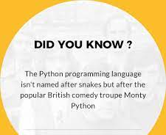

Slide 2
Brief History of Python
Invented in the Netherlands, early 90s by Guido Van Rossum
Open sourced from the beginning
Considered a scripting language, but is much more
Scalable, object oriented and functional from inception
Used by google from the beginning
Increasingly popular

Slide 3
FEATURES of Python
Easy-to-learn − Python has few keywords, simple structure, and a clearly defined syntax. This allows the user to pick up the language quickly.
Rich Standard Library Set – Python has a large and broad library and provides rich set of module and functions for rapid application development.
Portable − Python can run on a wide variety of hardware platforms and has the same interface on all platforms.
Dynamically Typed - Python is dynamically-typed. This means that the type for a value is decided at runtime, not in advance. This is why we don’t need to specify the type of data while declaring it.
Interpreted Language - Internally, Python converts the source code into an intermediate form called byte codes which is then translated into native language of specific computer to run it. An interpreter is a program that converts one statement of a program at one time.
Platform Independent - Python programs can be developed and executed on multiple operating system platforms without making any changes. Python can be used on Linux, Windows, Macintosh, Solaris and many more.

Slide 4
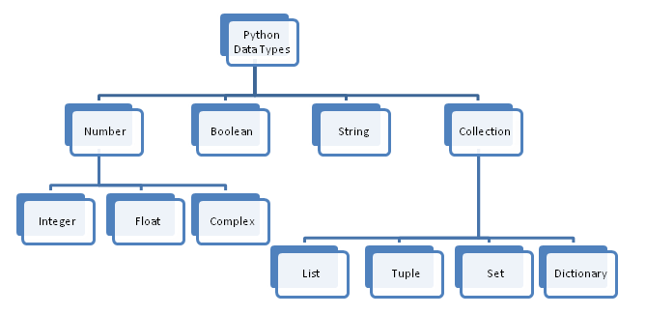
Data types

Slide 5
Basic Datatypes (1/4)
Int (signed integers) − they are often called just integers or int, are positive or negative whole numbers with no decimal point.
Default value is 0.
Float (floating point real values) − also called floats, they represent real numbers and are written with a decimal point dividing the integer and fractional parts.
Default value is 0.0
Complex (complex numbers) − are of the form a + bj., Where a and b are floats and J (or j) represents the square root of -1 (which is an imaginary number). The real part of the number is a, and the imaginary part is b. Complex numbers are not used much in python programming.
Default value is 0j

Slide 6
Basic Datatypes (2/4)
Boolean - boolean values are the two constant objects false and true.
Default value is false
String - Strings are amongst the most popular types in Python. It is collection of characters; we can create them simply by enclosing characters in quotes. Python treats single quotes the same as double quotes.
Default value for sting is “ “,’ ‘
List - The list is a most versatile data type available in Python which can be written as a list of comma-separated values (items) between square brackets. Important thing about a list is that items in a list need not be of the same type.
Default value is [], list()
Creating a list is as simple as putting different comma-separated values between square brackets.
list1 = ['Physics','Maths',2000,2004]
list2 = [1,2,3,4,5]
list3 = ['hello','world','learn','python']
Similar to string indices, list indices start at 0.

Slide 7
Basic Datatypes (3/4)
Tuple - A tuple is a sequence of immutable python objects. The differences between tuples and lists are, the tuples cannot be changed unlike lists and tuples use parentheses, whereas lists use square brackets.
Creating a tuple is as simple as putting different comma-separated values. Optionally you can put these comma-separated values between parentheses also.
Dictionary - each key is separated from its value by a colon (:), the items are separated by commas, and the whole thing is enclosed in curly braces. An empty dictionary without any items is written with just two curly braces, like this: {}.
Keys are unique within a dictionary while values may not be. The values of a dictionary can be of any type, but the keys must be of an immutable data type such as strings, numbers, or tuples.

Slide 8
Basic Datatypes (4/4)
Set - a set is an unordered collection data type that is iterable, mutable, and has no duplicate elements. In python sets are written with curly brackets.
Note: sets are unordered, so the items will appear in a random order.
Set values will be embedded in {}
Set will allow only the unique values (in case if there are any duplicates then those duplicate value should be removed)
Insertion order is not maintained.
Set will not support indexing

Slide 9
Operators (1/2)
Assignment operator - python assignment operators are used for assigning the value of the right operand to the left operand. Various assignment operators used in python are (=, +=, - =, *=, /=, etc.)
Relational operator - relational operators are used to establish some sort of relationship between the two operands. Python language is capable of understanding these types of operators and accordingly return the output, which can be either true or false (>, <,>=, <=,! =,== etc.)
Logical operator - logical operators, as the name suggests are used in logical expressions where the operands are either true or false. The operands in a logical expression can be expressions which return true or false upon evaluation. There are three basic types of logical operators:
And (&)
Or (||)
Not (~)
Arithmetic operator - arithmetic operators are used to perform mathematical operations like addition, subtraction, multiplication etc. (+, - ,*, /, %, //, **Etc.)

Slide 10
Operators (2/2)
Membership operator - in and not in are the membership operators in python. They are used to test whether a value or variable is found in a sequence (string, list, tuple, set and dictionary).
In a dictionary we can only test for presence of key, not the value.
Identity operator - is and is not are the identity operators in python. They are used to check if two values (or variables) are located on the same part of the memory. Two variables that are equal do not imply that they are identical.

Slide 11
Commenting in Python
Start comments with #, rest of line is ignored
Can include a “documentation string” as the description
Development environments, debugger, and other tools use it: it’s good practice to include comments
Def fact(n):
“““Fact(n) assumes n is a positive integer and returns facorial of n.””” Assert(n>0)
Return 1 if n==1 else n*fact(n-1)

Slide 12
Naming conventions
General
Names are case sensitive and cannot start with a number.
Good: user_profile, menu_options, word_definitions
When using CamelCase names, capitalize all letters of an abbreviation (E.g. HTTPserver)
Variables
Variable names should be all lower case
Words in an Variable name should be separated by an underscore
Non-public instance variables should begin with a single underscore
If an instance name needs to be mangled, two underscores may begin its name
Classes
Class names should follow the uppercasecamelcase convention
Python’s built-in classes, however are typically lowercase words
Exception classes should end in “error”
Methods
Method names should be all lower case
Words in an method name should be separated by an underscore
Non-public method should begin with a single underscore
If a method name needs to be mangled, two underscores may begin its name
Method arguments
Instance methods should have their first argument named ‘self’.
Class methods should have their first argument named ‘cls’
Functions
Function names should be all lower case
Words in a function name should be separated by an underscore
Constants
Constant names must be fully capitalized
Words in a constant name should be separated by an underscore
Reserved Keywords: ['False', 'None', 'True', '__peg_parser__', 'and', 'as', 'assert', 'async', 'await', 'break', 'class', 'continue', 'def', 'del', 'elif', 'else', 'except', 'finally', 'for', 'from', 'global', 'if', 'import', 'in', 'is', 'lambda', 'nonlocal', 'not', 'or', 'pass', 'raise', 'return', 'try', 'while', 'with', 'yield']

Slide 13
VARIABLES (1/2)
Variable: name of the memory location is called variable. Variable is used to store the data.
Initialization:
Assigning value to variable is called as Initialization
We can Assign data in variables by using Assignment Operator(=)
Assigning value means storing data in variables.
Syntax:
For assignment operator left side always Variable and right side always value
Right side data will store into left side variable

Slide 14
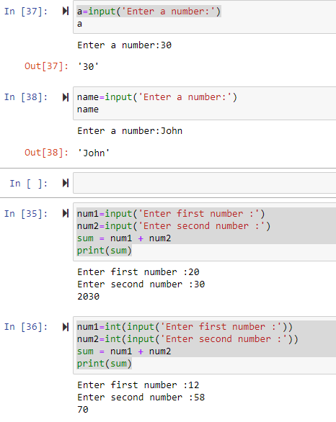
VARIABLES (2/2)
Input function: is used to provide user input to the program.
The default data type of input is string input is a function in python.

Slide 15
Functions (1/2)
Function in python:
A function is a group of logical related statements
Grouped into one block of statement
Re-usable
Python gives you many built-in functions like print (), etc. But we can also create our own functions. These functions are called user-defined functions.
Defining a function:
Here are simple rules to define a function in python.
Function blocks begin with the keyword def followed by the function name and parentheses (( )).
Any input parameters or arguments should be placed within these parentheses. You can also define parameters inside these parentheses.
The code block within every function starts with a colon (:) and is indented.
The statement return [expression] exits a function, optionally passing back an expression to the caller. A return statement with no arguments is the same as return none.

Slide 16
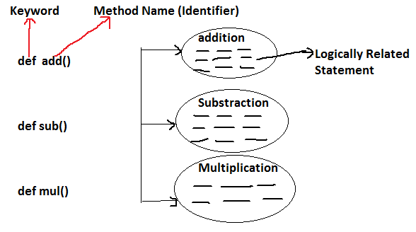
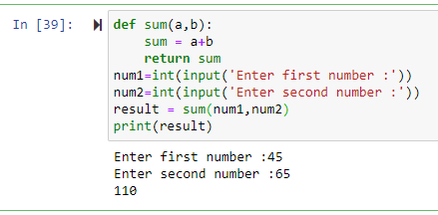
Functions (2/2)
The default data type of function is ‘none’.
If user is not returning any value then python will return none statement
It is always best practice to write return statement at the end of function otherwise the statements which are present after return statement will not be executed.
User also can return his own value

Slide 17
String
A string is a sequence of characters enclosed within single quotes or double quotes.
Str represents string data type.
Single Quoted Strings s1='Venkat’
Double Quoted Strings s1="Venkat"
Triple Quoted Strings: By using single quotes or double quotes we cannot represent multi line string literals. so, Triple Quotations are invented.
s1='''Venkat
technologies''' → Triple single quotes for multi-line string
(or)
s1="""Venkat
technologies""" → Triple-double quotes for multi-line string

Slide 18
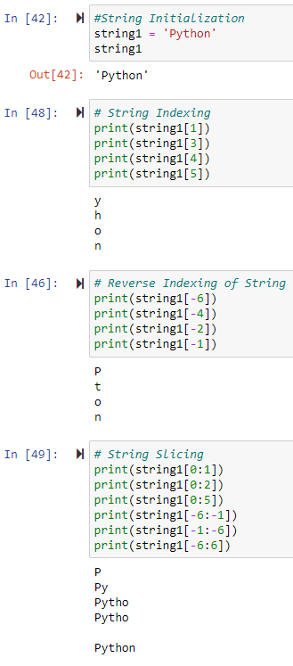
String slicing and string indexing
Slice means a piece/part
In python, strings follow zero based index.
The index can be either +ve or -ve.
Positive index means forward direction i.e. From left to right
Negative index means backward direction i.e. From right to left

Slide 19
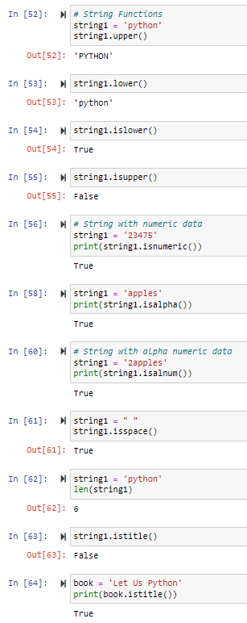
String Functions:
upper()
lower()
islower()
isupper()
islower()
isnumeric()
isalnum()
isalpha()
isspace()
isspace()
len(string1)
istitle()

Slide 20
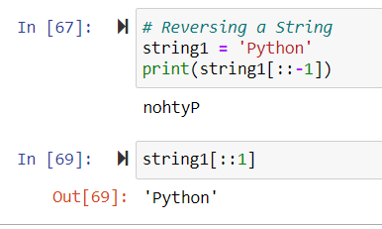
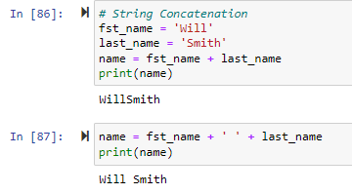
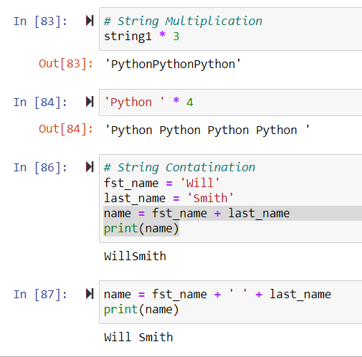
String Reversing:
String Concatenation:
String Multiplication :

Slide 21
LIST (1/2)
A list can be used for storing a group of elements enclosed within [ ]
List will allow Duplicate Elements
List will allow null values
List will maintain the insertion Order
List is mutable
We can retrieve the data from List based on Index
 | Method | Description
1 | append() | Add a single element to the end of the list
2 | clear() | Removes all Items from the List
3 | copy() | Returns Shallow Copy of a List
4 | count() | returns occurrences of element in a list
5 | extend() | Add Elements of a List to Another List
6 | index() | returns smallest index of element in list
7 | insert() | Inserts Element to The List
8 | len() | Returns Length of an Object
9 | max() | returns largest element
10 | min() | returns smallest element
11 | pop() | Removes element at the given index
12 | remove() | Removes item from the list
13 | reverse() | Reverses a List
14 | sort() | sorts elements of a list
15 | sum() | Add items of an Iterable

Slide 22
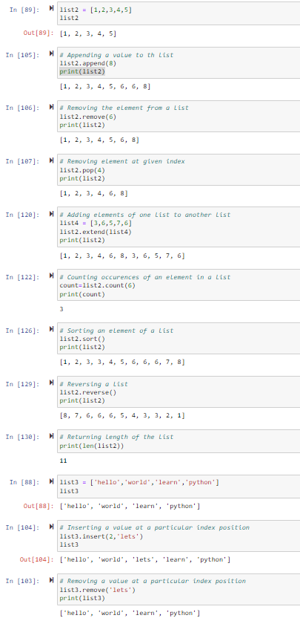
LIST (2/2)

Slide 23
TUPLES (1/2)
A tuple can be used for storing a group of elements enclosed within ()
Tuple will allow Duplicate Elements
Tuple will allow null values
Tuple will maintain the insertion Order
Tuple is immutable
We can retrieve the data from tuple based on Index
Method | Description
count() | returns occurrences of element in a tuple
index() | returns smallest index of element in tuple
len() | Returns Length of an Object
max() | returns largest element
min() | returns smallest element
sorted() | returns sorted list from a given iterable
sum() | Add items of an Iterable
tuple() | Creates a Tuple

Slide 24
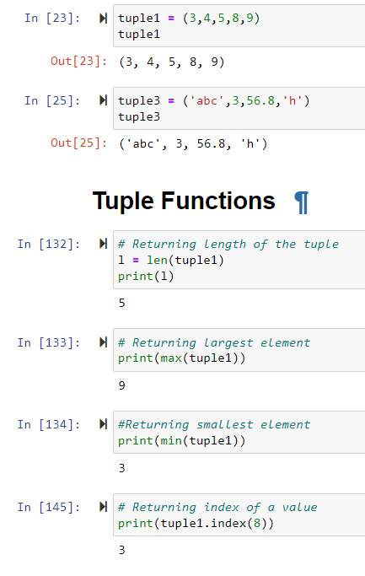
TUPLES (2/2)

Slide 25
SET
Method | Description
remove() | Removes Element from the Set
add() | adds element to a set
copy() | Returns Shallow Copy of a Set
clear() | remove all elements from a set
difference() | Returns Difference of Two Sets
discard() | Removes an Element from The Set
intersection() | Returns Intersection of Two or More Sets
issubset() | Checks if a Set is Subset of Another Set
issuperset() | Checks if a Set is Superset of Another Set
pop() | Removes an Arbitrary Element
symmetric_difference() | Returns Symmetric
Difference union() | Returns Union of Sets
update() | Add Elements to The Set
len() | Returns Length of an Object
max() | returns largest element
A set can be used for storing a group of elements enclosed within {}
set will not allow Duplicate Elements
set will allow null values
set will not maintain the insertion Order
set is mutable

Slide 26
Dictionary(1/2)
A dictionary can be used for storing a group of elements in key and value pair format and enclosed within {}
Key will not allow duplicates and value will allow duplicates
Insertion order
Key will not allow None
Dictionary is a mutable object
Method | Description
clear() | Removes all Items
copy() | Returns Shallow Copy of a Dictionary
get() | Returns Value of The Key
items() | Returns view of dictionary's (key, value) pair
keys() | Returns View Object of All Keys
popitem() | Returns & Removes Element From Dictionary
setdefault() | Inserts Key With a Value if Key is not Present
pop() | Removes and returns element having given key
values() | Returns view of all values in dictionary
update() | Updates the Dictionary
dict() | Creates a Dictionary
len() | Returns Length of an Object
max() | returns largest element
min() | returns smallest element
map() | Applies Function and Returns a List
sorted() | Returns sorted list from a given iterable
sum() | Add items of an Iterable

Slide 27
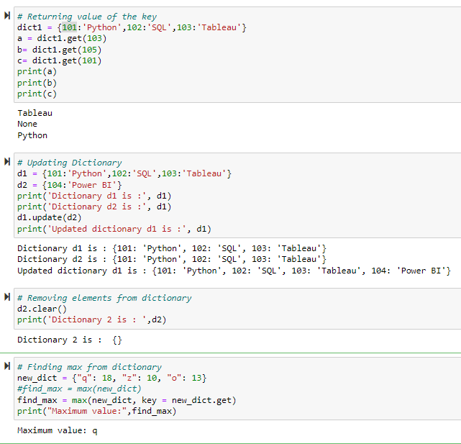
DICTIONARY(2/2) - Examples

Slide 28
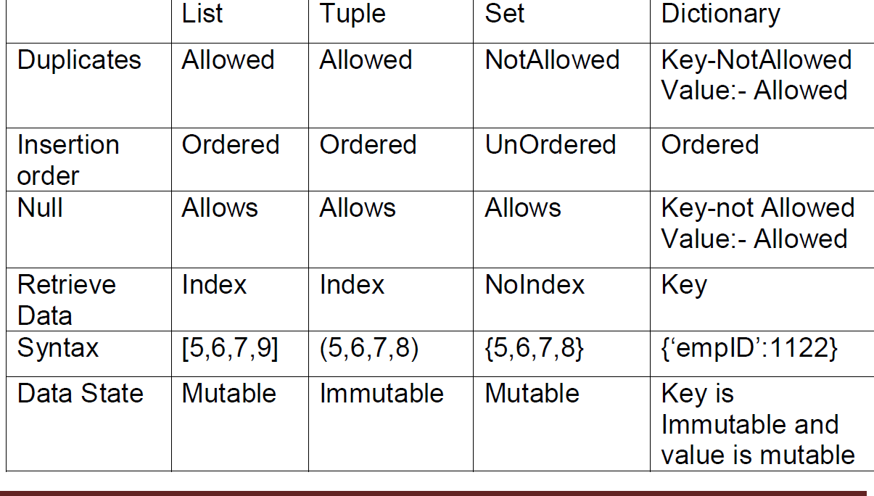
COMPARISION

Slide 29
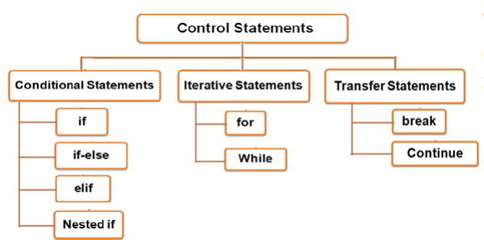
Control Flow Statements (1/2)
Control flow is the order in which the program’s code executes

Slide 30
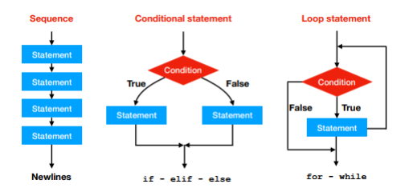
Control Flow Statements(2/2)

Slide 31
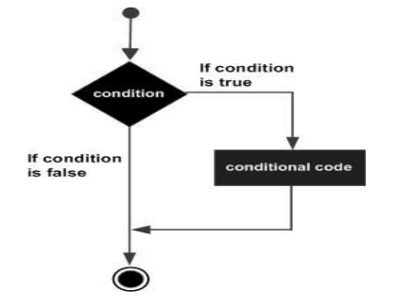
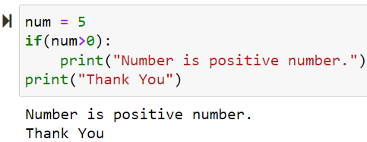
Conditional Statements(1/4)
Decision-making helps in deciding the flow of execution of the program It simply decides whether a particular code block will be executed or not on the basis of the condition provided in the if statement. If the condition true, then the code block is executed, and if it’s false then the code block is not executed.
If statement:
used to execute a group of statements based on the result of a condition.
Syntax:
If(codition):
Statement-1
Statement-2
Flow chart:
Example:

Slide 32
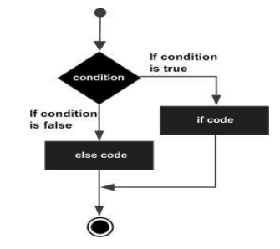
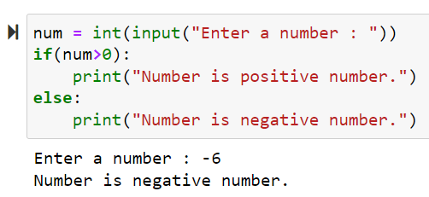
Conditional Statements(2/4)
If else:
used to execute group of statements based on a condition, if the condition is true then it will execute if-block otherwise it will execute else-block
Syntax:
if(condition):
Statement-1
else:
Statement-2
Flowchart :
Example:

Slide 33
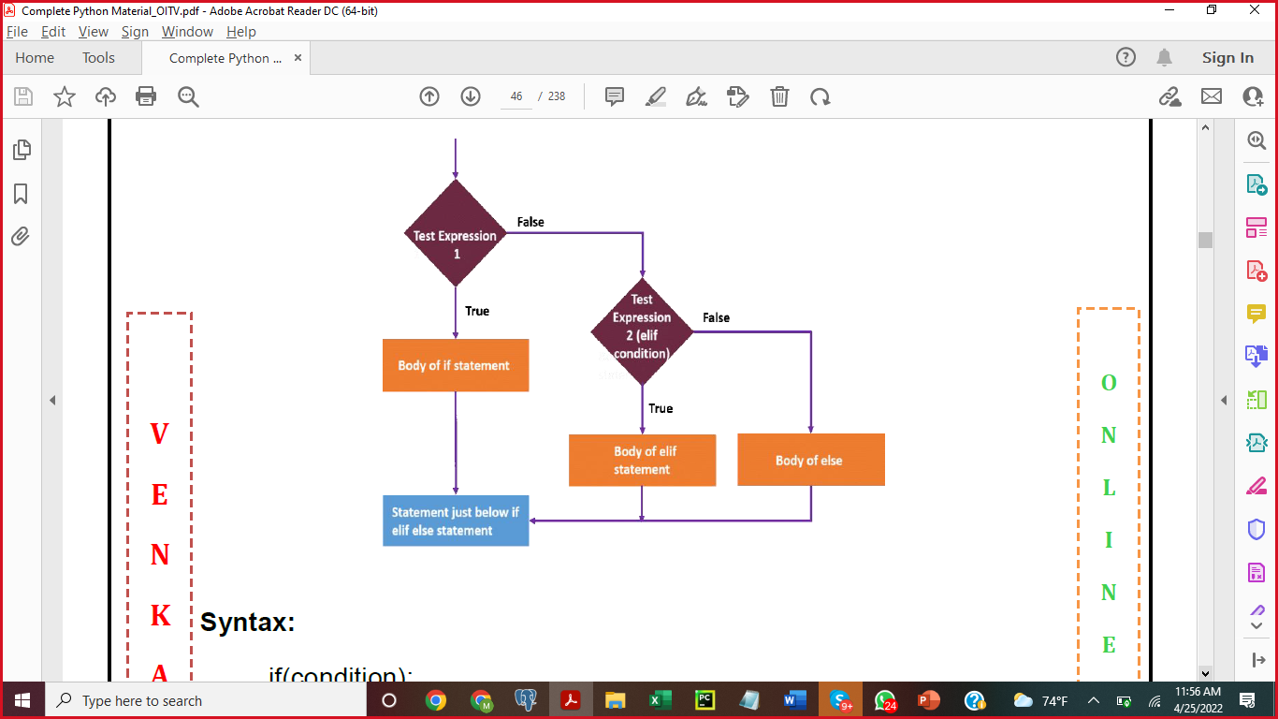
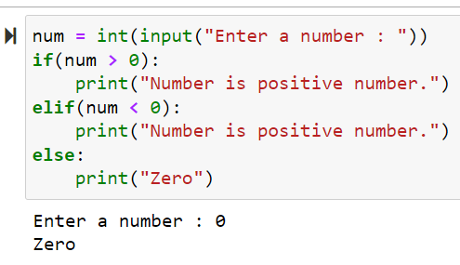
Conditional Statements(3/4)
Elif :
is used when you need to choose one between more than two alternatives. Syntax:
if(condition):
Statement -1
elif(condition):
Statement -2
else:
Statement -3
Flowchart :
Example:

Slide 34
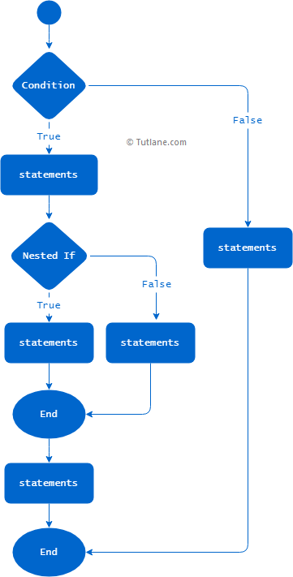
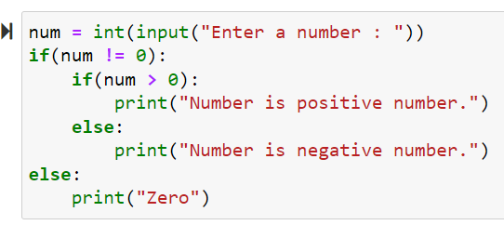
Conditional Statements(4/4)
Nested if:
If Statement presents inside of another if statement then it is called as nested-if.
Flowchart :
Example:
Syntax
if expression1:
statement(s)
if expression2:
statement(s)
elif expression3:
statement(s)
elif expression4:
statement(s)
else:
statement(s)
else:
statement(s)

Slide 35
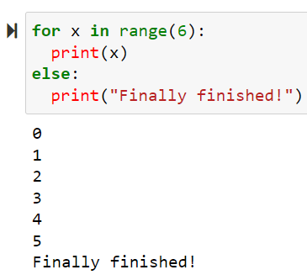
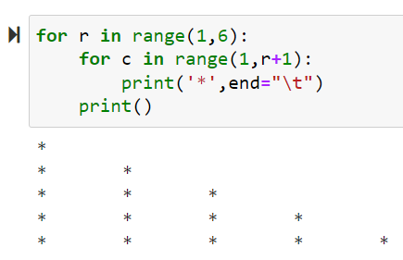
ITERATIVE/Looping STATEMENTS(1/5)
RANGE FUNCTION:
The statements can be repeated according to our requirement with the help of range() function. The range() can be used in following ways
range(endvalue): This range() will begin from 0 and continues upto the specified "endvalue-1"
range(startvalue, endvalue): This range() will begin from the specified "startvalue" and continues upto the specified "endvalue-1"
range(startvalue, endvalue, stepvalue): This range() will begin from the specified "startvalue" and continues upto the specified "endvalue-1" and it will increase or decrease with the specified "stepvalue"
If the "stepvalue" is not specified then the default "stepvalue" is 1.
Note: If you know number of iterations then use for-loop otherwise use While-loop

Slide 36
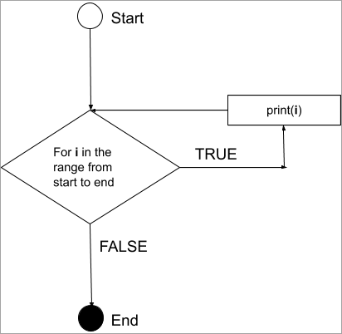
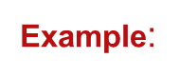
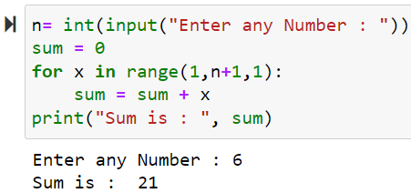
ITERATIVE/Looping STATEMENTS(2/5)
for loop:
"for loop" is a repetition process which is used to execute group of statements repeatedly within the given range.
Syntax:
for variable in range()/str/sequence:
statement1
statement2
.......

Slide 37
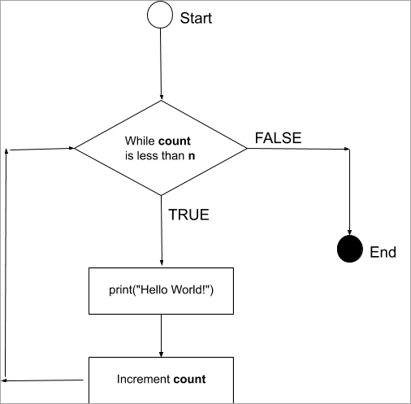
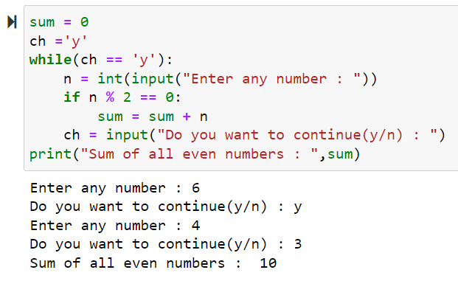
ITERATIVE/Looping STATEMENTS(3/5)
while loop:
"while loop" is executing group of statements repeatedly based on the condition as long as a condition is true.
Syntax:
while <condition>:
statement(s)

Slide 38
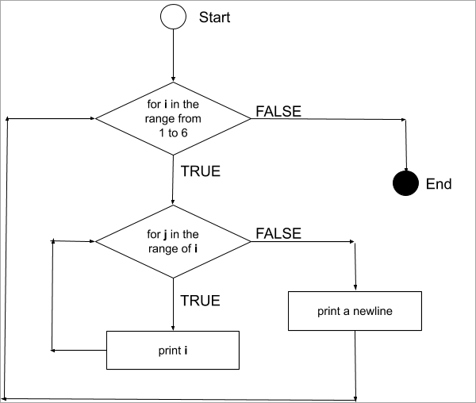
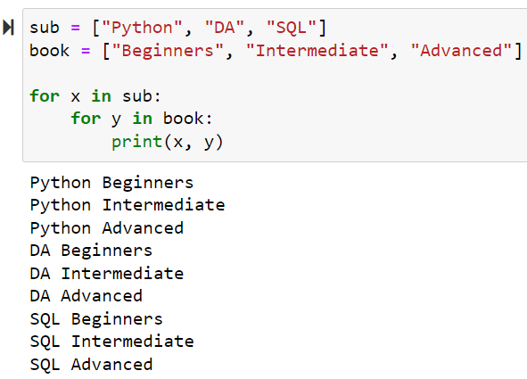
ITERATIVE/Looping STATEMENTS(4/5)
Nested Loops
Nesting For Loops
for loops can be nested within themselves.
The syntax below shows a 1-level nested for loop.
for in n:
# piece of code goes here
for in n:
# piece of code goes here

Slide 39
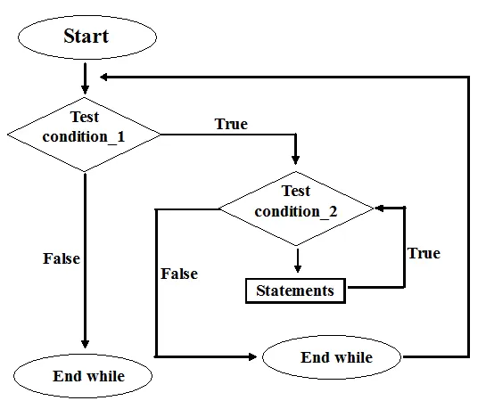
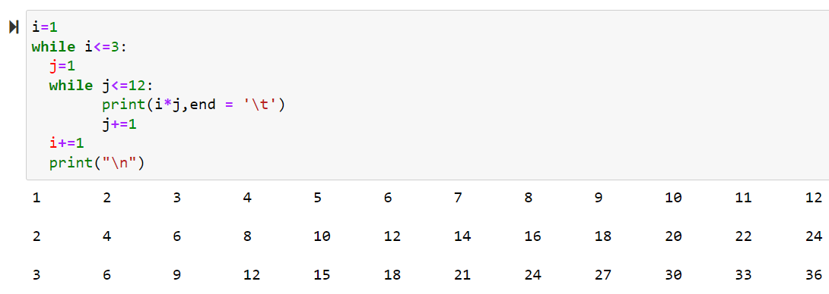
ITERATIVE/Looping STATEMENTS(5/5)
Nesting While Loops
While loops can be nested within themselves.
The syntax below shows a 1-level nested while loop.
while condition:
# piece of code goes here
while condition:
# piece of code goes here

Slide 40
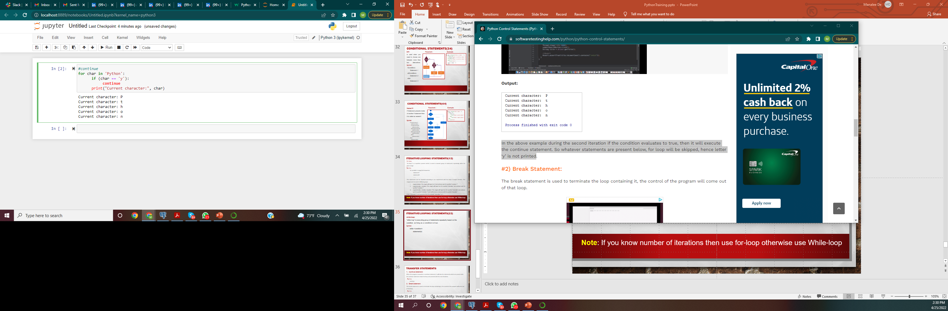
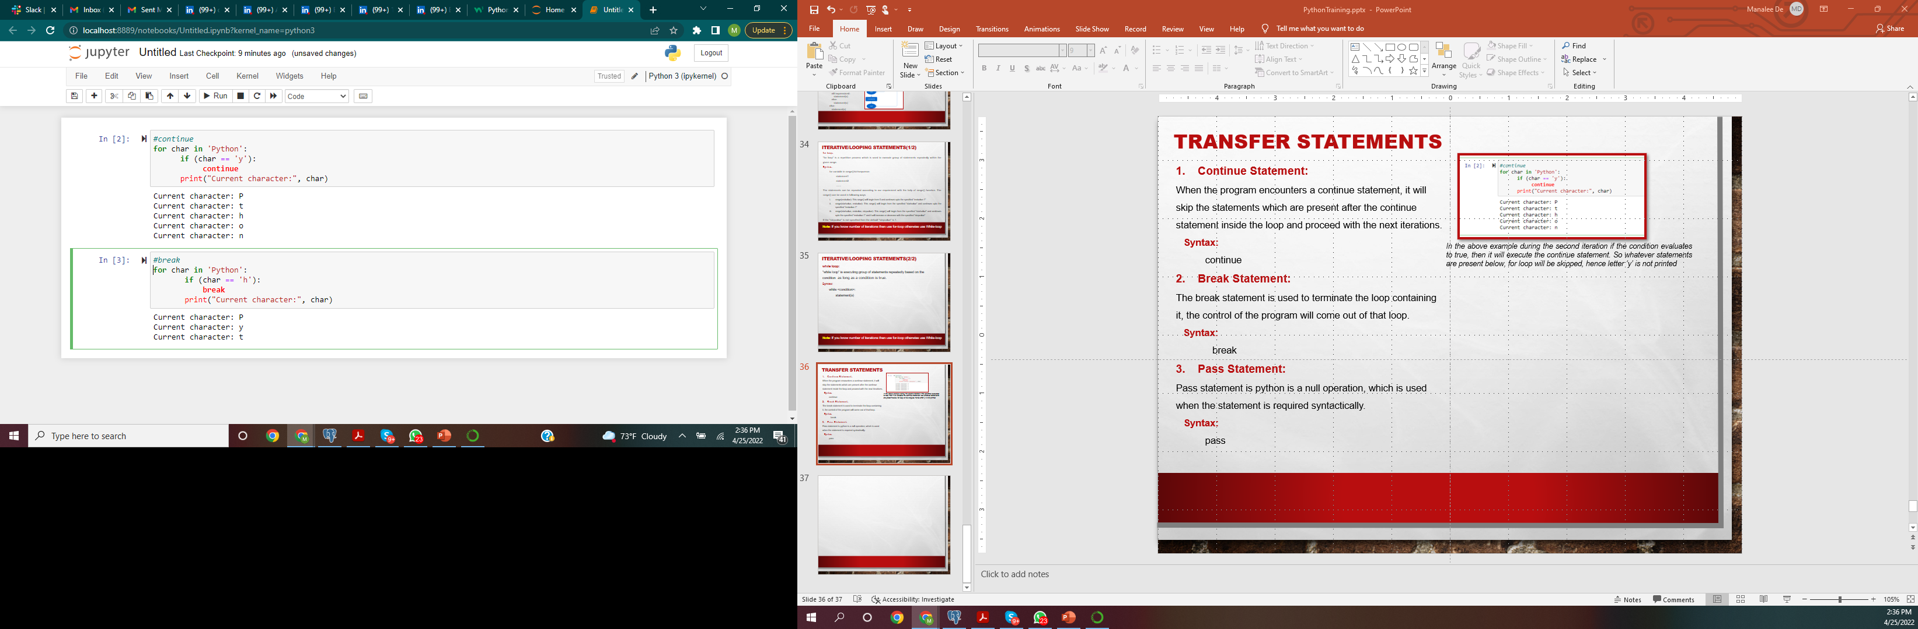
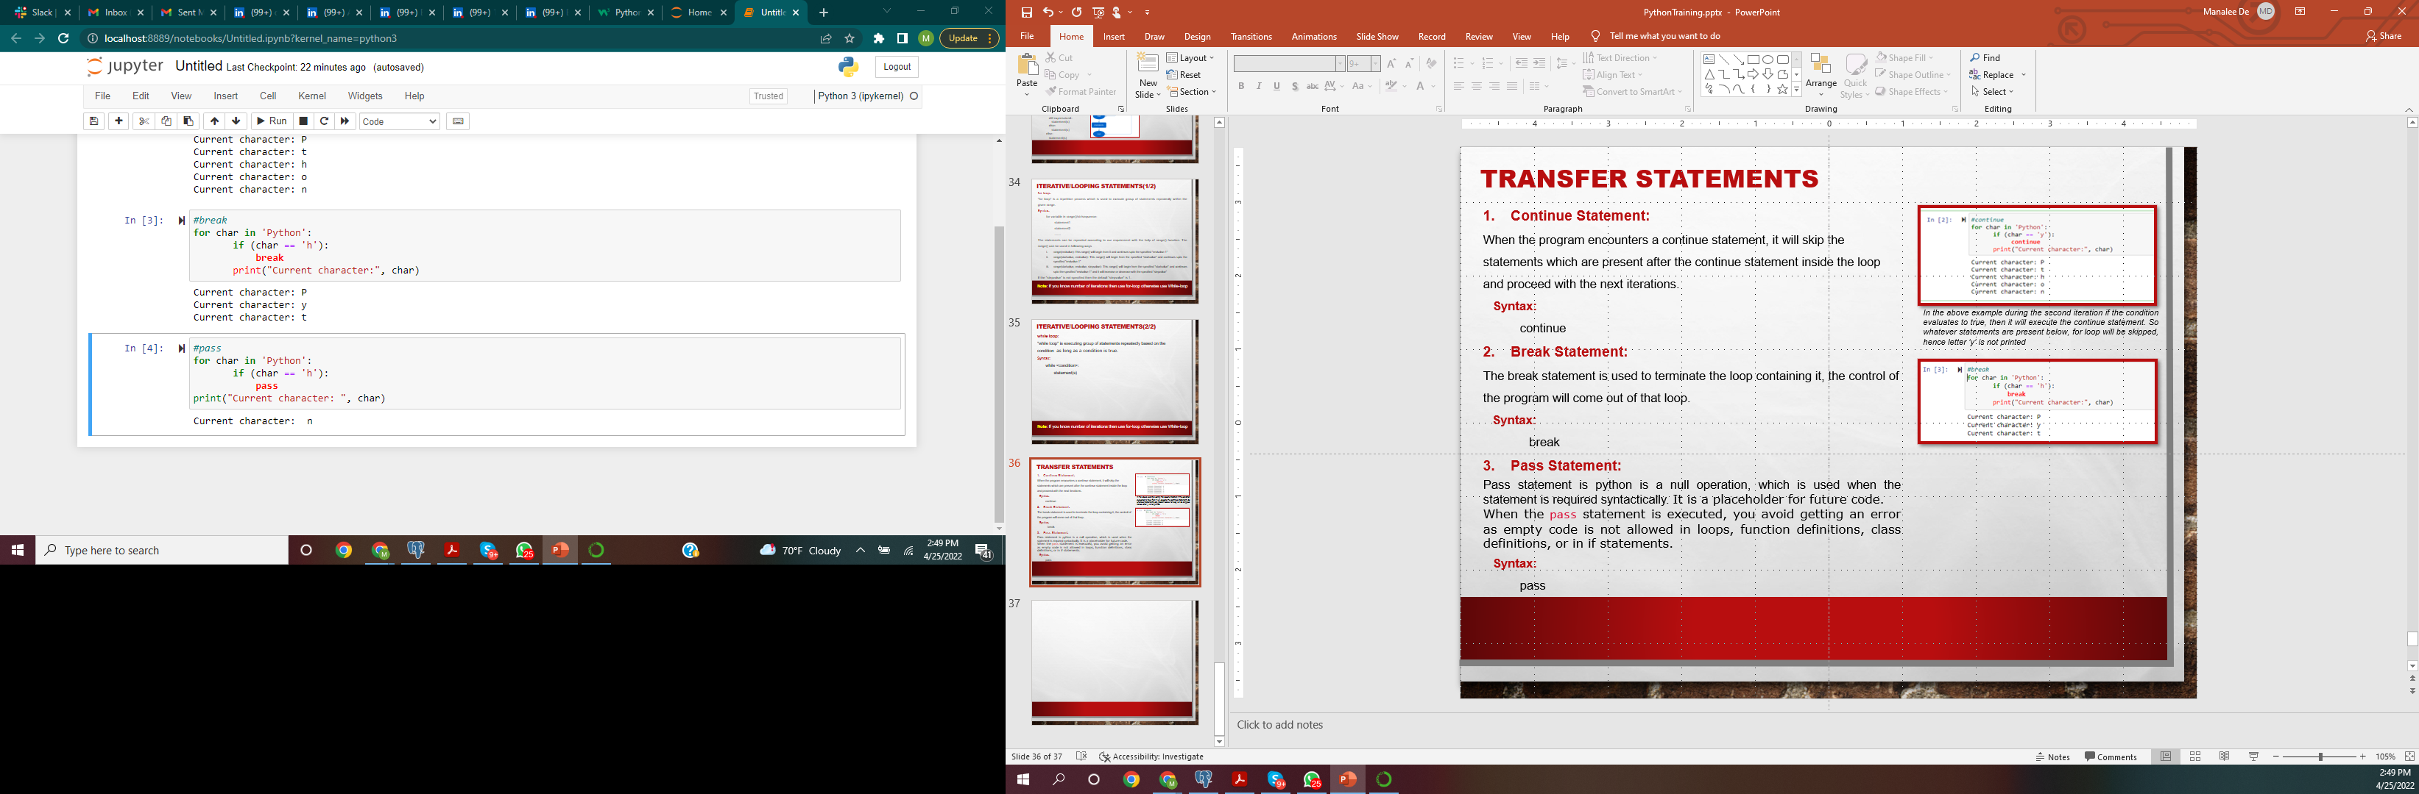
Transfer Statements
Continue Statement:
When the program encounters a continue statement, it will skip the statements which are present after the continue statement inside the loop and proceed with the next iterations.
Syntax:
continue
Break Statement:
The break statement is used to terminate the loop containing it, the control of the program will come out of that loop.
Syntax:
break
Pass Statement:
Pass statement is python is a null operation, which is used when the statement is required syntactically. It is a placeholder for future code.
When the pass statement is executed, you avoid getting an error as empty code is not allowed in loops, function definitions, class definitions, or in if statements.
Syntax:
pass
In the above example during the second iteration if the condition evaluates to true, then it will execute the continue statement. So whatever statements are present below, for loop will be skipped, hence letter ‘y’ is not printed

Slide 41
Thank You

